Slide 1
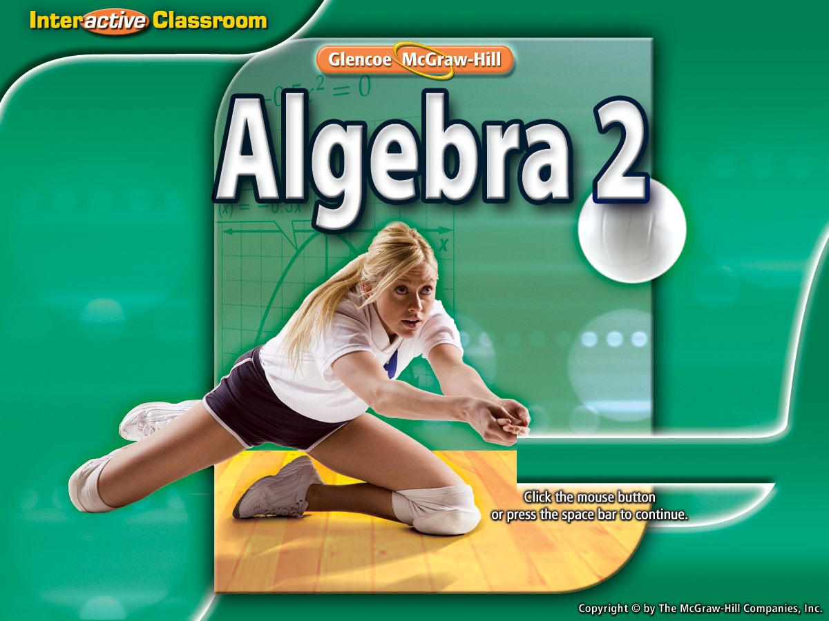


Splash Screen

Slide 2
Lesson Menu
Then/Now
New Vocabulary
Example 1: Solve by Using a Table
Example 2: Solve by Graphing
Example 3: Real-World Example: Break-Even Point Analysis
Example 4: Classify Systems
Concept Summary: Characteristics of Linear Systems

Slide 3


Then/Now
You graphed and solved linear equations. (Lesson 2–2)
Solve systems of linear equations by using tables and graphs.
Classify systems of linear equations.

Slide 4


Vocabulary
system of equations
break-even point
consistent
inconsistent
independent
dependent

Slide 5
Example 1
Solve by Using a Table
Solve the system of equations by completing
a table.
x + y = 3
–2x + y = –6
Solve for y in each equation.
x + y = 3
y = –x + 3
–2x + y = –6
y = 2x – 6

Slide 6
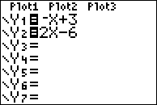
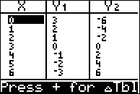
Example 1
Solve by Using a Table
Use a table to find the solution that satisfies both equations.
This table can be created by hand or on the calculator.
Step 1: Solve for y
Step 2: plug equations into Y1 & Y2
Step 3: Push 2nd/Graph to view the table
Step 4: Find the point that the equations have in common.
This is the point
where an x-value
gives the same
y-value for each
equation, Y1 & Y2.
Answer: The solution to the system is (3, 0).

Slide 7


Example 1
What is the solution of the system of equations?
x + y = 2
x – 3y = –6
Solve for y. Then, plug into Y1 & Y2. Look at table to see
intersection point.
A. (1, 1)
B. (0, 2)
C. (2, 0)
D. (–4, 6)
A
B
C
D

Slide 8
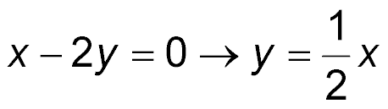
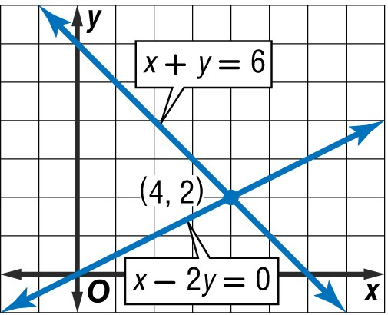

Example 2
Solve by Graphing
Solve the system of equations by graphing.
x – 2y = 0
x + y = 6
Write each equation in slope-intercept form.
The graphs appear to
intersect at (4, 2).

Slide 9

Example 2
Solve by Graphing
Check Substitute the coordinates into each equation.
x – 2y = 0 x + y = 6 Original equations
?
?
4 – 2(2) = 0 4 + 2 = 6 Replace x with 4
and y with 2.
0 = 0 6 = 6 Simplify.
Answer: The solution of the system is (4, 2).

Slide 10
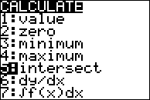
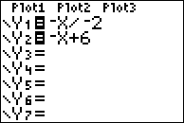
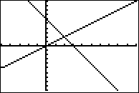
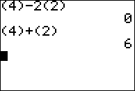
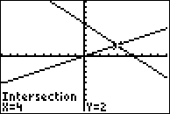
SO
To solve a system of equations, using TI-84:
Step 1: Solve for y
Step 2: Plug equations into y=
Step 3: Graph
  Change WINDOW until you can see the intersection point of the lines.
Step 4: 2nd/Trace/5:Intersection/Enter/Enter/Enter
Step 5: The intersection of the lines is the solution to the system of equations.
Step6: Use home screen to plug solution in and double check work.
Solve the system of equations by graphing.
x – 2y = 0
x + y = 6
Solution: (4, 2)
Step 6
Step 1 & 2
Step 3
Step 4

Slide 11
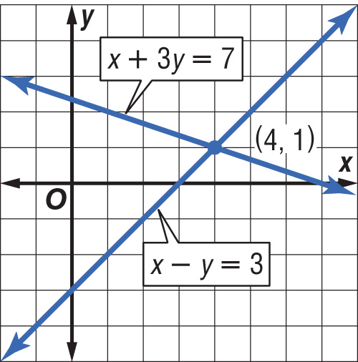
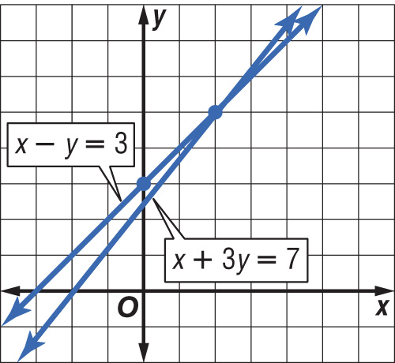
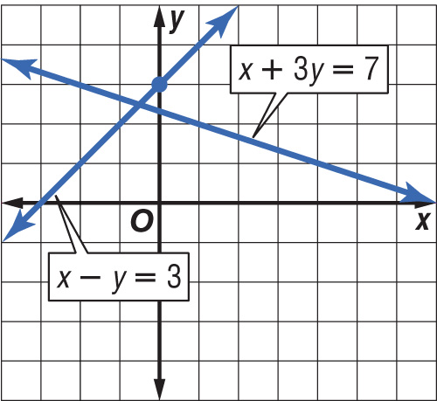
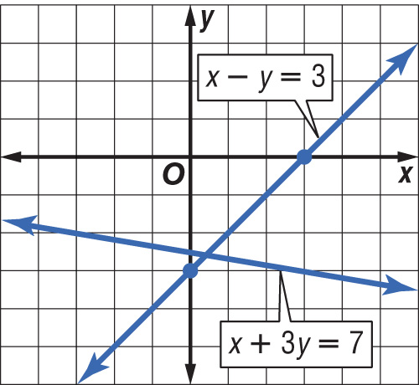
Example 2
Which graph shows the solution to the system of equations below?
x + 3y = 7
x – y = 3
A.
C.
A
B
C
D
B.
D.

Slide 12
Example 3
Break-Even Point Analysis
SALES A service club is selling copies of their holiday cookbook to raise funds for a project. The printer’s set-up charge is $200, and each book costs $2 to print. The cookbooks will sell for $6 each. How many cookbooks must the members sell before they make a profit?
Let x = the number of cookbooks, and let
y = the number of dollars.
Cost of books
is
cost per book
plus
set-up charge.
y
=
2x
+
200

Slide 13
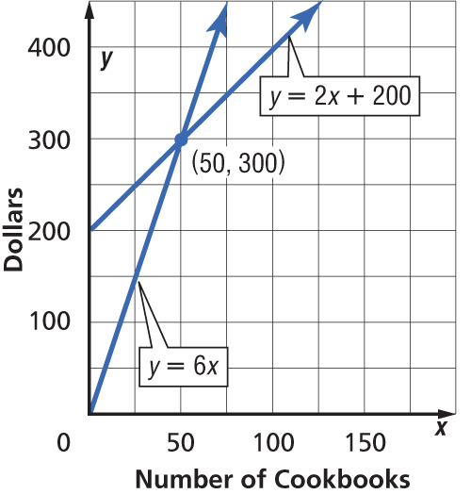
Example 3
Break-Even Point Analysis
Income from
books
price per
book
number of
books.
is
times
y
=
6
•
x
The graphs intersect at
(50, 300). This is the break-even point. If the group sells fewer than 50 books, they will lose money. If the group sells more than 50 books, they will make a profit.
Answer: The club must sell at least 51 cookbooks to make a profit.

Slide 14
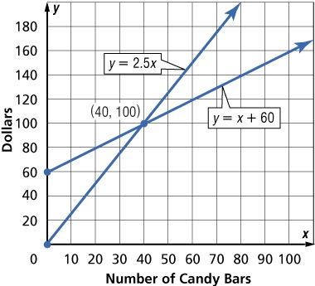
Example 3
The student government is selling candy bars. It costs $1 for each candy bar plus a $60 set-up fee. The group will sell the candy bars for $2.50 each. How many do they need to sell to break even?
A. 0
B. 40
C. 60
D. 80
A
B
C
D

Slide 15
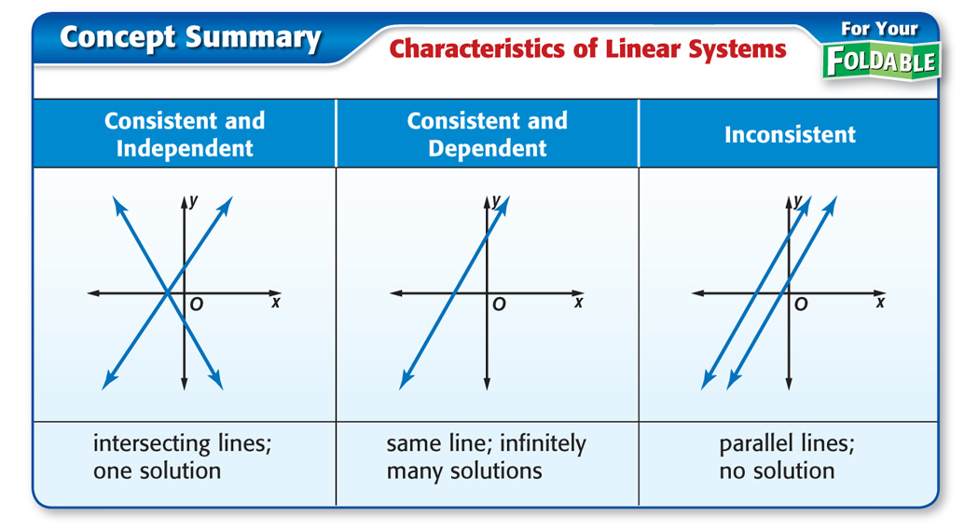
Concept

Slide 16

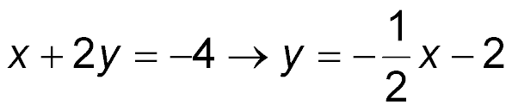
Example 4
Classify Systems
A. Graph the system of equations and describe it as consistent and independent, consistent and dependent, or inconsistent.
x – y = 5
x + 2y = –4
Write each equation in slope-intercept form.

Slide 17
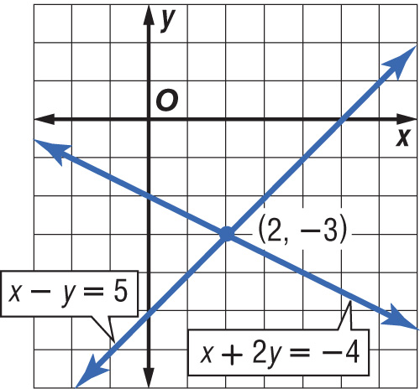
Example 4
Classify Systems
Answer:
The graphs of the equations intersect at (2, –3). Since there is one solution to this system, this system is consistent and independent.

Slide 18
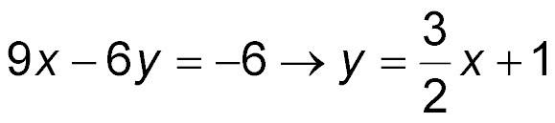
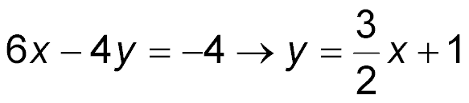
Example 4
Classify Systems
B. Graph the system of equations and describe it as consistent and independent, consistent and dependent, or inconsistent.
9x – 6y = –6
6x – 4y = –4
Write each equation in slope-intercept form.
Since the equations are equivalent, their graphs
are the same line.

Slide 19
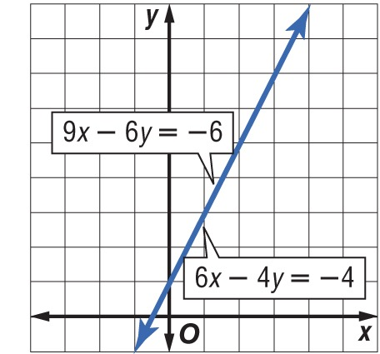
Example 4
Classify Systems
Answer:
Any ordered pair representing a point on that line will satisfy both equations. So, there are infinitely many solutions. This system is consistent and dependent.

Slide 20
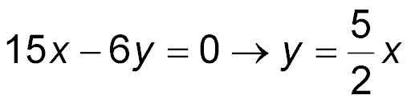
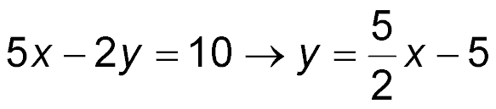
Example 4
Classify Systems
C. Graph the system of equations and describe it as consistent and independent, consistent and dependent, or inconsistent.
15x – 6y = 0
5x – 2y = 10
Write each equation in slope-intercept form.

Slide 21
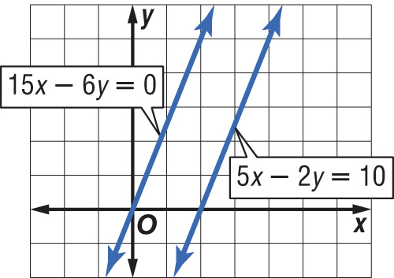
Example 4
Classify Systems
Answer:
The lines do not intersect. Their graphs are parallel lines. So, there are no solutions that satisfy both equations. This system is inconsistent.

Slide 22
Example 4
Classify Systems
D. Graph the system of equations and describe it as consistent and independent, consistent and dependent, or inconsistent.
f(x) = –0.5x + 2
g(x) = –0.5x + 2
h(x) = 0.5x + 2

Slide 23
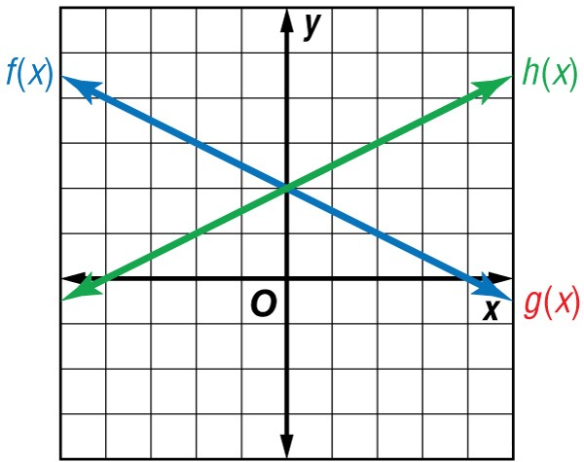
Example 4
Classify Systems
Answer:
f(x) and g(x) are consistent and dependent. f(x) and h(x) are consistent and independent. g(x) and h(x) are consistent and independent.

Slide 24
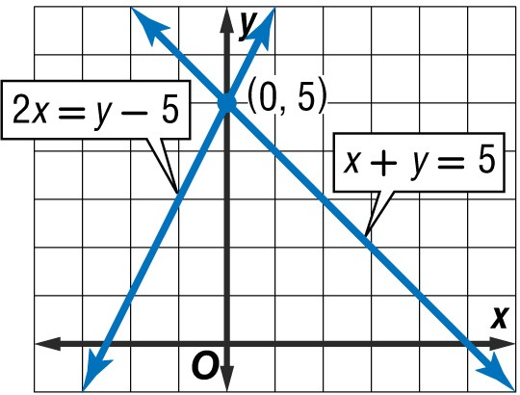
Example 4
A. Graph the system of equations below. What type of system of equations is shown?
x + y = 5
2x = y – 5
A. consistent and independent
B. consistent and dependent
C. consistent
D. none of the above
A
B
C
D

Slide 25
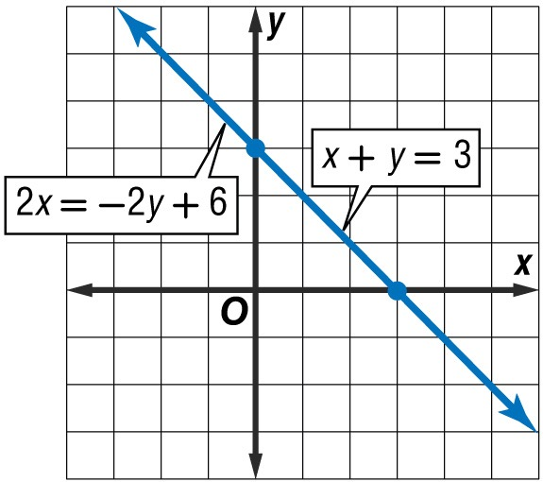
Example 4
B. Graph the system of equations below. What type of system of equations is shown?
x + y = 3
2x = –2y + 6
A. consistent and independent
B. consistent and dependent
C. inconsistent
D. none of the above
A
B
C
D

Slide 26
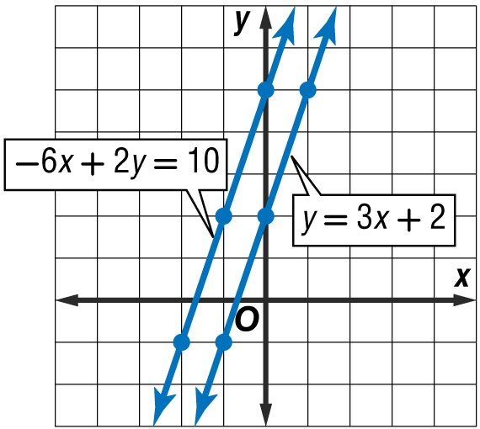
Example 4
C. Graph the system of equations below. What type of system of equations is shown?
y = 3x + 2
–6x + 2y = 10
A
B
C
D
A. consistent and independent
B. consistent and dependent
C. inconsistent
D. none of the above

Slide 27
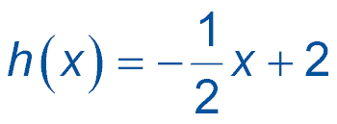
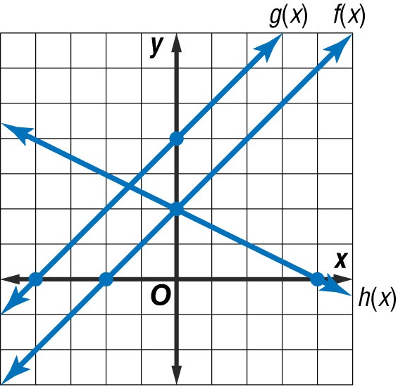
Example 4
D. Graph the system of equations below. Which statement is not true?
f(x) = x + 2 g(x) = x + 4
A. f(x) and g(x) are consistent and dependent.
B. f(x) and g(x) are inconsistent.
C. f(x) and h(x) are consistent and independent.
D. g(x) and h(x) are consistent
A
B
C
D

Slide 28
End of the Lesson

